Slide 1
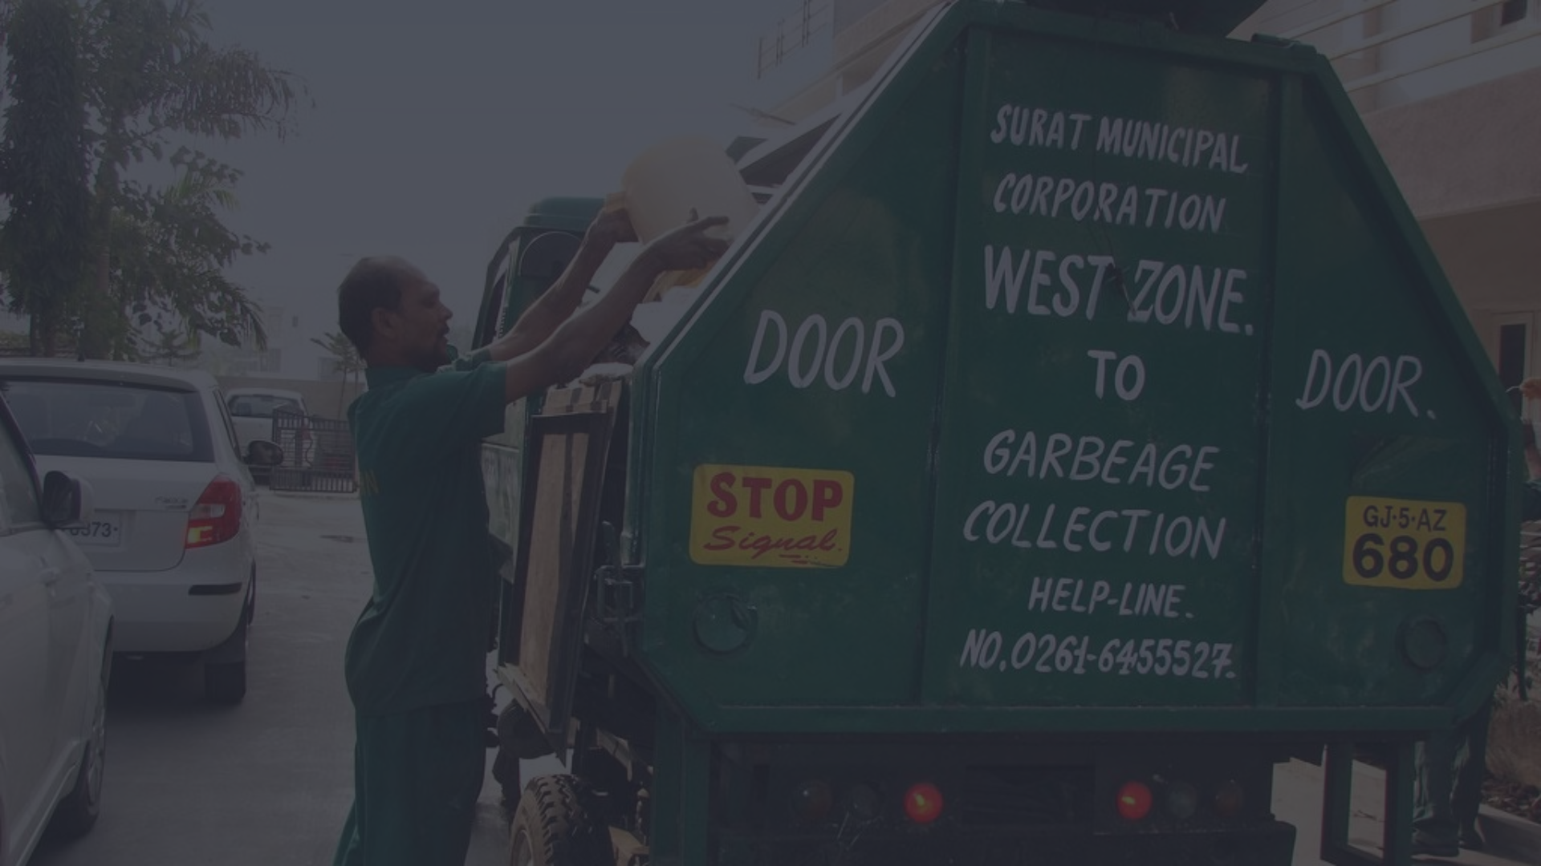

Smart Waste Management System
for Smart City & better planet
Discover the power of smart waste management systems that leverage cutting-edge computer vision and machine learning technologies to revolutionize waste collection and recycling. Explore innovative solutions that optimize efficiency, reduce environmental impact, and drive sustainable change.
Guided By:
Dnyanesh Ghan
Presented By:
Mitali S. Ghorpade
Bhavesh S. Mane
Irfan k. Shaikh
Omkar A. Waghmare
Yogesh Sananse

Slide 2

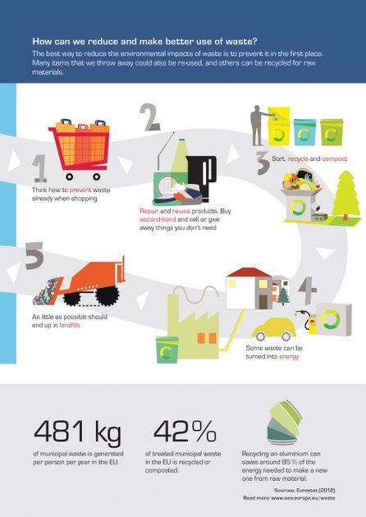
Problem Statement
Waste management is a major problem in cities and towns across the globe. Many regions around the world don’t have a proper waste collection and disposal system, and where there are such systems, they’re often not very efficient.
Some of the problem statements are as follows:
1. Waste Management system is not getting operated in proper way
2. No visibility of actual wastes collected at central location
3. Collections happening through small vehicles leading to some waste spread across roads
4. Vehicle trips happening randomly and in some case with sub filled loads. This leads to additional consumptions of fuel and increase the carbon footprint.

Slide 3
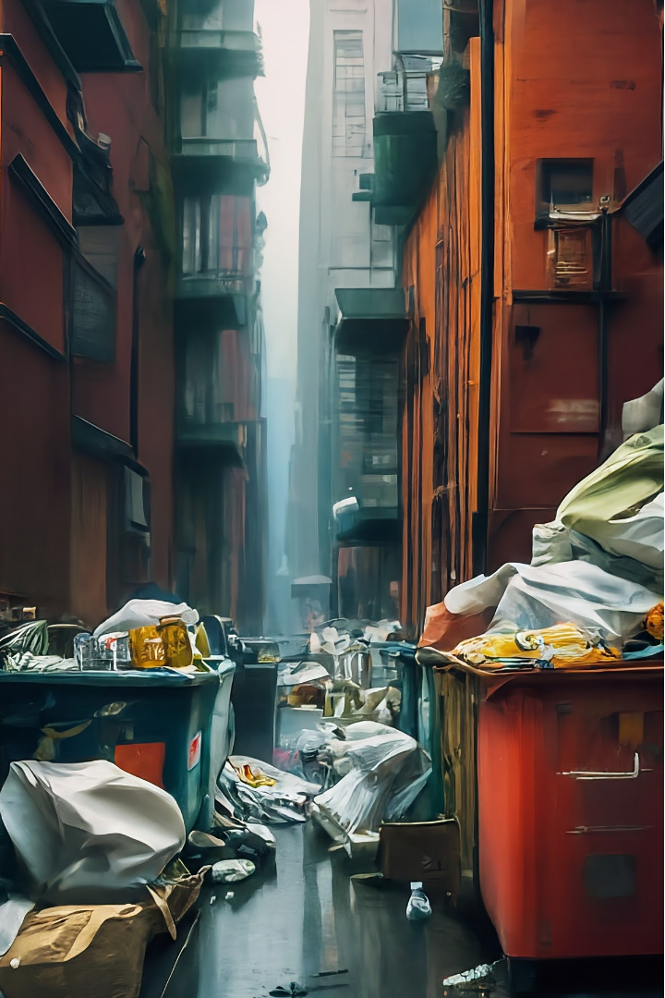
Challenges in Traditional Waste Management
Lack of efficient collection and transportation systems, leading to waste piling up in urban areas.
Insufficient segregation of waste at the source, making it difficult to recycle and repurpose materials.
Outdated landfill management practices, leading to environmental pollution and health concerns for nearby communities.

Slide 4
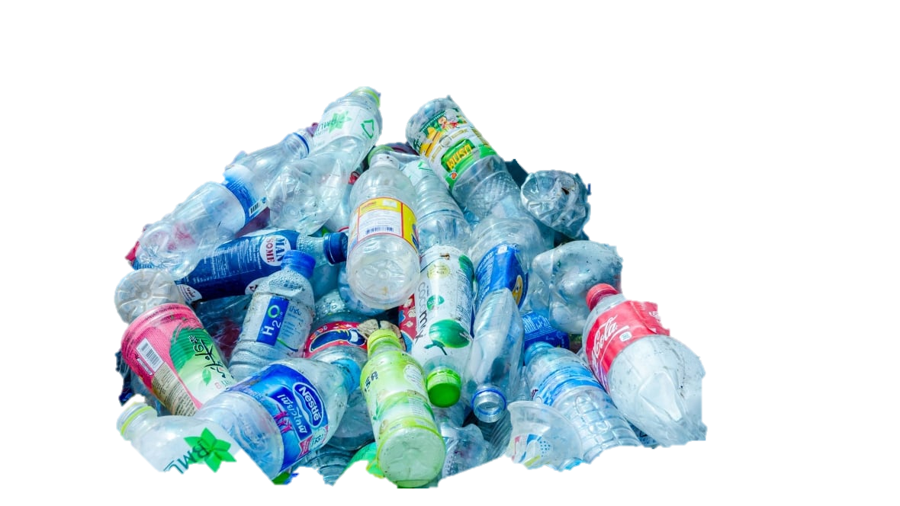
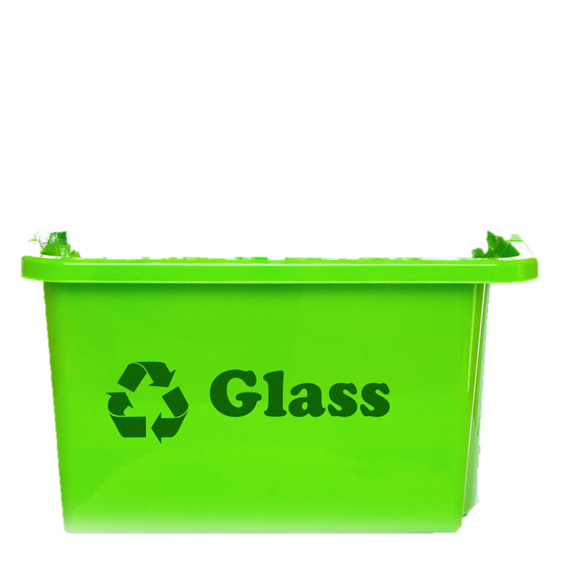
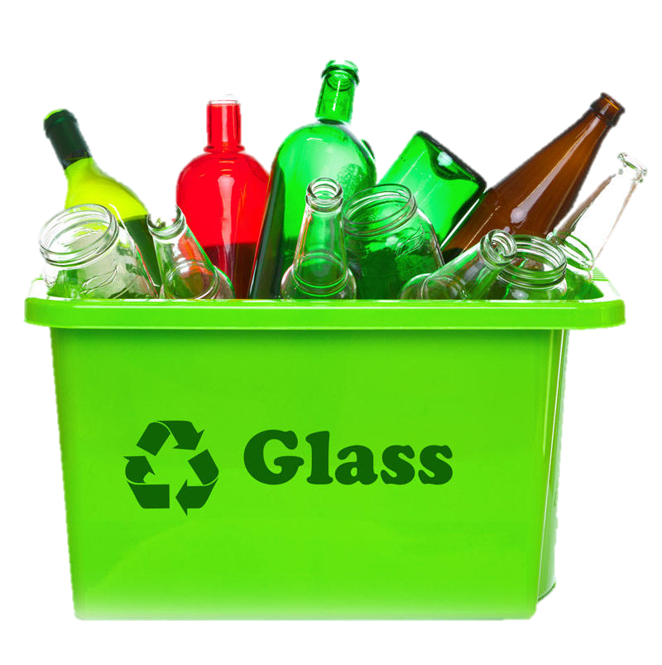
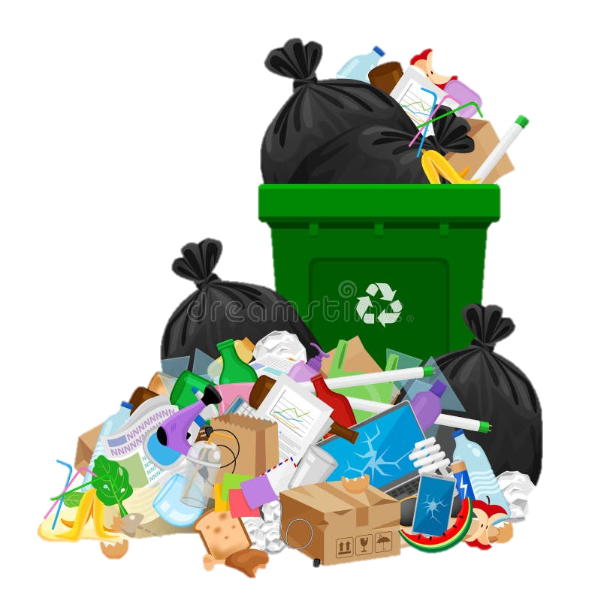

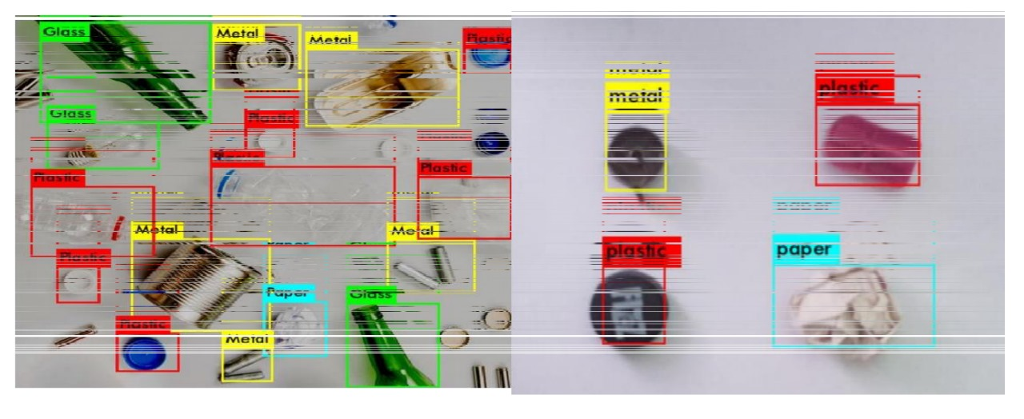
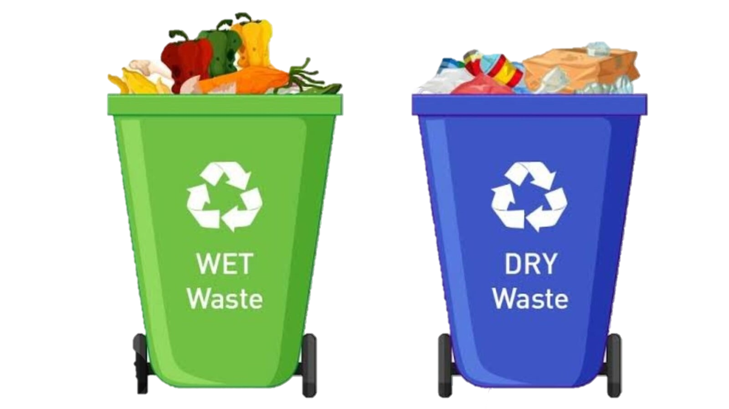
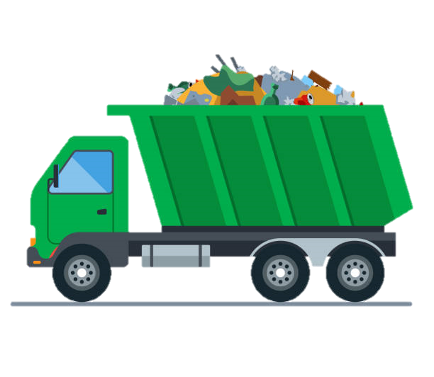
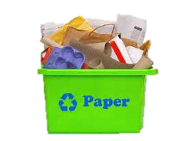

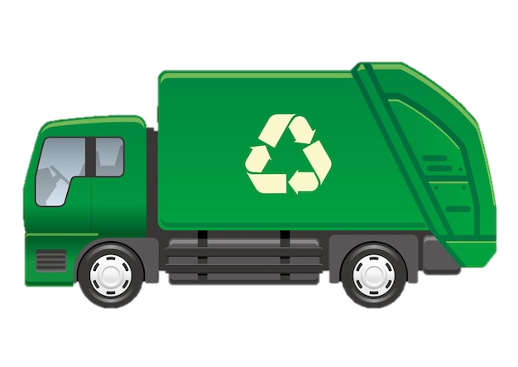
Our Approach
Plastic

Slide 5

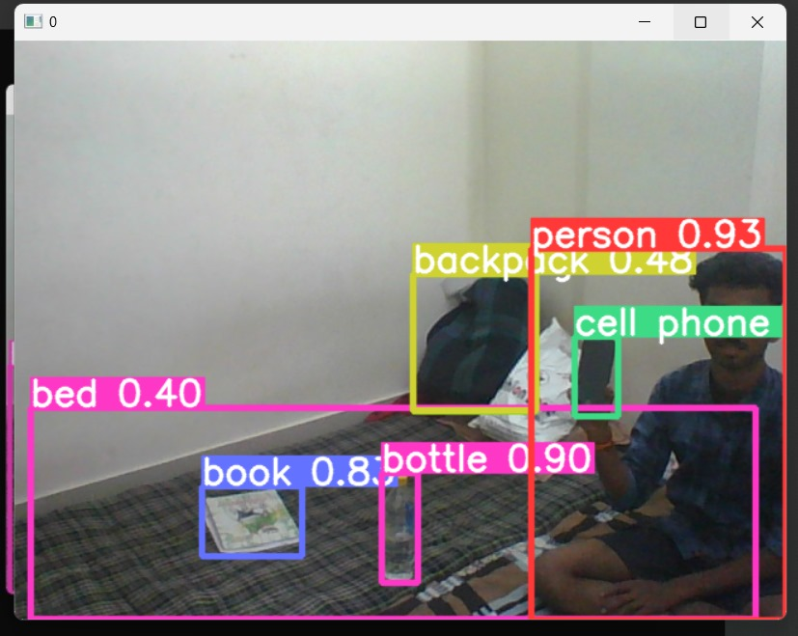
Solution
All Garbage is stored in dumping ground.
That garbage will go through machine, enabled with our algorithm module, which will detect and sort different materials.
Module name: Full form of YOLO is You Only Look Once. It is basically use to classify object.
Module Work: We can train a neural network to classify different types of object. Here we have to give 10,000 images as a class to the algorithm to classify object according to their need Its used to object detection.
What is Classes for algorithm: Click the picture of objects like plastic, paper, metal etc so algorithm can sort the object It is easy to sort if all the garbage is collected together We need not any person to sort it by hand.
Before Detection
After Detection

Slide 6
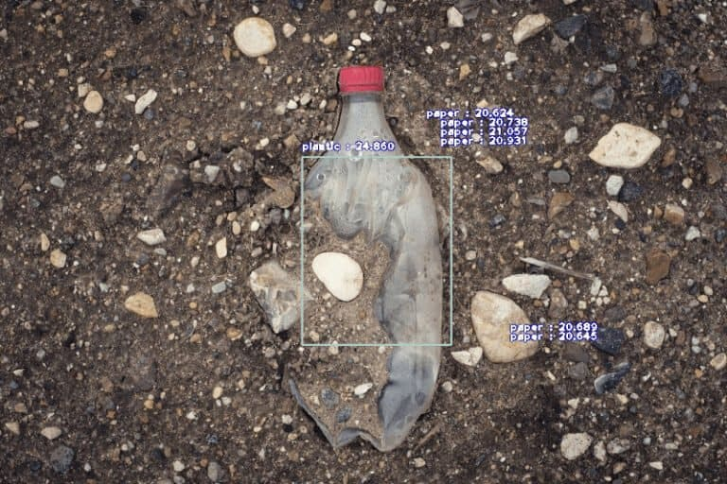
Overview of YOLO V5 Computer Vision
YOLO V5 is a state-of-the-art real-time object detection system powered by deep learning. It uses a convolutional neural network to rapidly identify and locate multiple objects within an image, making it ideal for applications like smart waste management.
The algorithm excels at detecting and classifying diverse waste items with high accuracy and speed, providing crucial data for optimizing collection and recycling efforts.

Slide 7
Applying YOLO V5 to Waste Detection
YOLO V5, a state-of-the-art object detection model, can be leveraged to identify and classify different types of waste in real-time. By training the model on a comprehensive dataset of waste objects, the system can accurately detect and categorize waste, enabling efficient waste management.
The fast and reliable detection capabilities of YOLO V5 can be integrated into a smart waste management system, providing valuable insights into waste composition and quantities at various collection points.

Slide 8
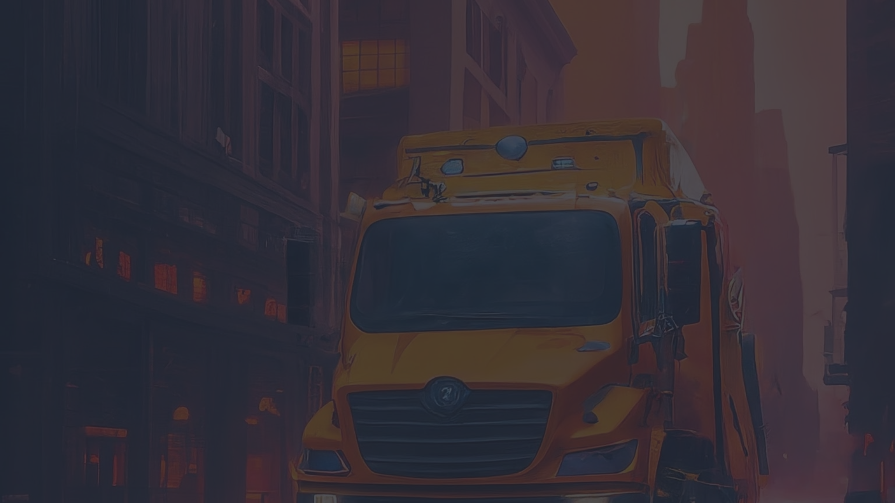



Optimizing Waste Collection Routes
Route Optimization
Sensor Integration
Predictive Analytics
Use AI-powered algorithms to analyze waste generation patterns and optimize collection routes for efficiency, reducing fuel consumption and emissions.
Deploy smart sensors in waste receptacles to monitor fill levels and trigger collection only when necessary, further optimizing routes.
Leverage historical data and machine learning to predict waste generation hotspots and adjust collection schedules accordingly.

Slide 9




Engaging the Community for Participation
Waste Sorting Workshops
Community Cleanup Events
Waste Reporting App
Stakeholder Collaboration
Host interactive workshops to educate residents on proper waste sorting and recycling practices, encouraging active community participation in the smart waste management system.
Organize regular neighborhood cleanup events to collect and properly dispose of waste, fostering a sense of pride and ownership in the local environment.
Develop a user-friendly mobile app that allows residents to easily report waste-related concerns, such as illegal dumping or overflowing bins, enabling quick response and community involvement.
Facilitate regular meetings between community leaders, waste management experts, and local authorities to gather feedback and incorporate community needs into the smart waste system.

Slide 10

Here are some screenshots

Slide 11
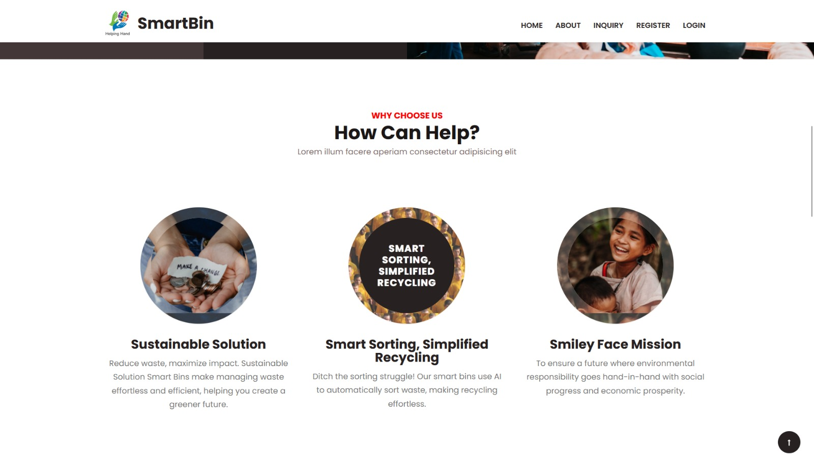

Slide 12
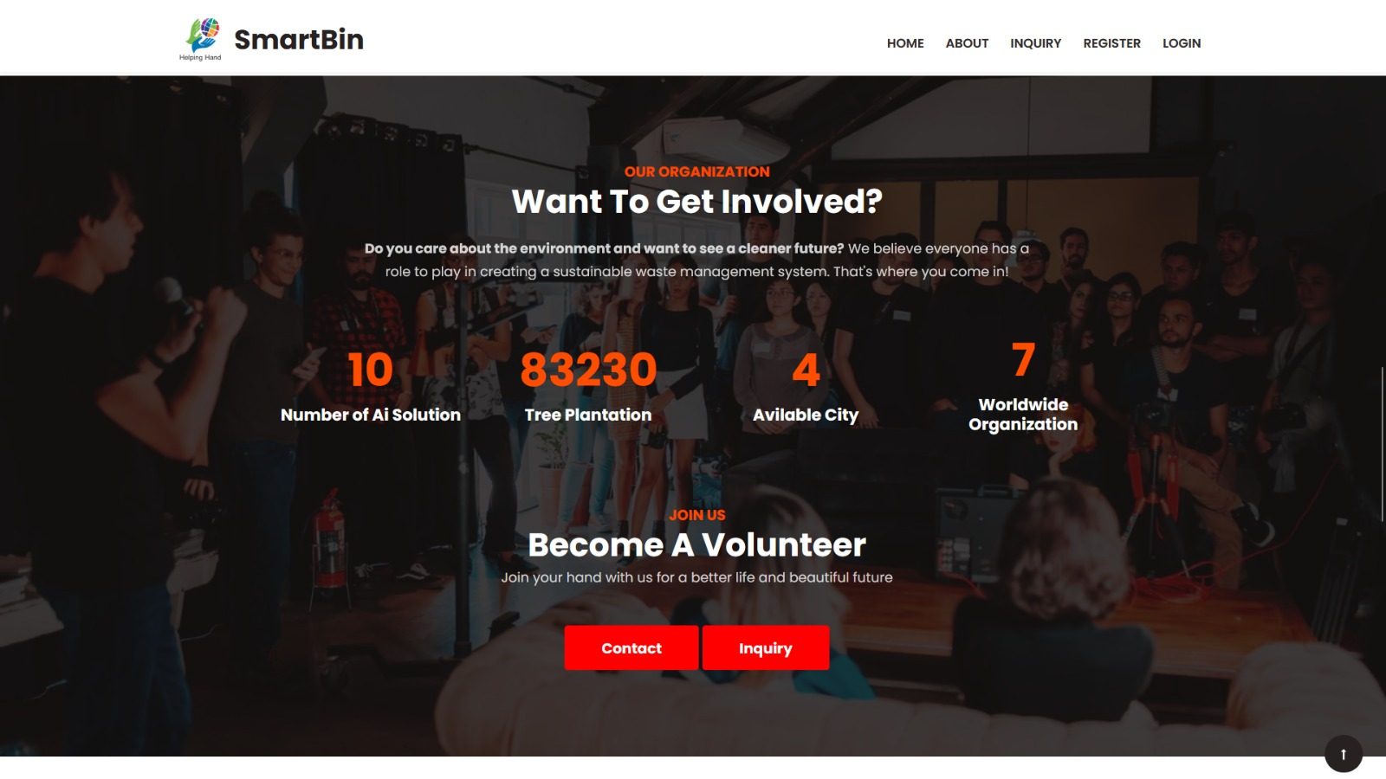

Slide 13

Conclusion
In conclusion, the smart waste management system leveraging YOLO V5 computer vision and machine learning has the potential to revolutionize waste management practices. By automating waste detection, classification, and route optimization, this innovative approach can significantly improve efficiency, reduce costs, and drive sustainable waste reduction initiatives.

Slide 14

Thank You
Any Questions ?

